Slide 1

DV1C04 Final Coursework Assignment

Slide 2

DevOps Operate & Monitor Assignment

Slide 3

About ITnGreen Organization
ITnGreen is a organization that promotes green energy in information technology industry. The various green technologies are shared in its internet website. The organization is based in Singapore.

Slide 4
About the Assignment
ITnGreen Organisation wants to use DevOps to improve its operation and monitoring capabilities. You are tasked to set up Proof-of-Concept (POC) to automate operation for ItnGreen Organization. You are required to set up a DevOps Operate pipeline with 5 stages. You must insert screenshots for your implementation in this assignment report (report template is provided).
In addition, there are several monitor related questions (within report template) raised by ITnGreen that need to be answered by you.
You need to upload your assignment report via File Submission to SA 2.0.

Slide 5
Assignment Submission
Please refer to the attached Power Point slides for instruction on submission to SA2.0.
You are to upload your assignment to SA2.0. in two files:
One file is your coursework assignment report
One file is your recorded video explaining your design in your submitted report. (Your video should last only 5-10minutes.)
Assignment Report Submission Closing Date & Time:
24th April 2022, 23:00.

Slide 6
Requirements – Monitor
There are several Monitor related questions as listed in the report assignment template that need to be answered by you.

Slide 7
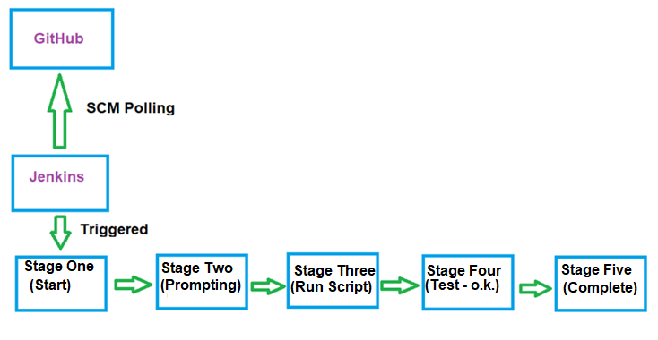
Requirements – Operate Pipeline Overview
The purpose of the following pipeline is to replace the original apache2’s index.html file with a given index.html file. The replacement must be done in the pipeline. The installation of container’s web server package (apache2) must be done via the pipeline.

Slide 8
Requirements – Operate Pipeline
You need to design a pipeline, with diagram(s) and explanations, bases on the assignment requirements in your report. You need to capture screenshots of your implementation in your report.
Before creating the Pipeline, you need to:
create one docker container
For operate pipeline, you need to:
create one Jenkins pipeline with 5 stages to replace index.html page
Details of the above requirements are provided in the subsequent slides.

Slide 9
Requirement 1 – Create One Docker Container
Description | Configuration / Settings
Docker Container Name | websvr_<your student id>
Operating System | ubuntu 18.04
Persistent Run and in detached mode? | Yes
IP Address (CIDR notation) | 192.168.100.200 / 24 (Hint: you may need to create custom network)
Hostname | websvr_<your student id>
Configure as | Puppet Client
Install package apache2 | via Jenkins Pipeline
*Create the container following strictly the naming convention as indicates above.

Slide 10
Requirement 2 – Create One Jenkins Pipeline
Description | Configuration / Settings
Pipeline Name | operate_<your student id>
SCM | https://github.com/<your account>/operate_repo/<your student id>_jenkinsfile
Trigger Method | Poll SCM
Poll Interval | Every Minutes
Pipeline Definition | Pipeline Script from SCM
*Create pipeline following strictly the naming convention as indicates above.

Slide 11
Requirement 2 (Cont’)
Stage Number | Stage Name
Stage 1 | <Your Student ID> Stage One
Stage 2 | <Your Student ID> Stage Two
Stage 3 | <Your Student ID> Stage Three
Stage 4 | <Your Student ID> Stage Four
Stage 5 | <Your Student ID> Stage Five
* Create stages following strictly the naming convention as indicates above.

Slide 12
Requirement 2 (Cont’)
Stage Name | Step(s) within stage
<your student id> Stage One | echo “<your student id> Start of Pipeline”
<your student id> Stage Two | echo “Push changes to Production?” Proceed or Abort?
< your student id> Stage Three | Execute “bolt script run ‘/…/<your student ID_script>’ ……..” (Refer to Requirement 3) echo “Stage 3 Completed - <your student id>”
< your student id> Stage Four | echo “Production website tested working” (assume there is a test done in this phase)
< your student id> Stage Five | echo “Production website is updated successfully”
*Create stages’ activities following strictly as indicates above.

Slide 13
Requirement 3
The following file’s content must be shown in the report.
Files must be in GitHub repository your github account>/<your student ID_repo> :
Filename : <your student ID>_jenkinsfile
(Hint: Contains all the stages and steps for Jenkins build)
Filename: index.html
(Hint: For updating to container’s /var/www/html/index.html)
File must be in sddo-vm’s directory /<your student ID>/script_dir:
Filename: <your student ID>_script
(Important: This script is used by bolt to replace index.html file and ensure apache2 is installed (using puppet resource command) on the target container.
Hint: may use lesson 10 for reference)
Follow the naming convention strictly as indicates above.

Slide 14
Requirement 3 (Cont’)
The index.html file’s content for replacing the original apache2 server webpage is given as shown below.
<html>
<head>
</head>
<body>
<h1>My student ID is <your student ID> <h1>
</body>
</html>

Slide 15
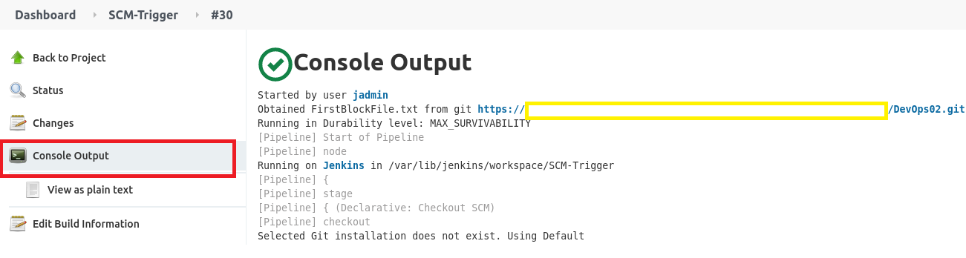
Further Requirements
You are expected to capture all necessary screenshots to serve as evidence of your implementation.
You are also expected to provide a screenshot of complete Console Output of one complete successful build. Please remove your personal access token from the output (yellow highlight below). For example:

Slide 16
Further Requirements (Cont’)
You are expected to use the provided report template for your assignment report. You must follow closely the guidelines for each sections of the report.
*The report content should be within 4000 words (not counting any wordings which are originally in the template ). Too much irrelevant content in the report will be penalised.

Slide 17
End of DevOps Operate & Monitor Assignment Requirements

